Slide 1
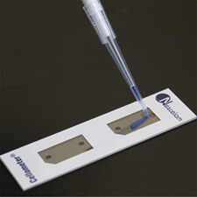
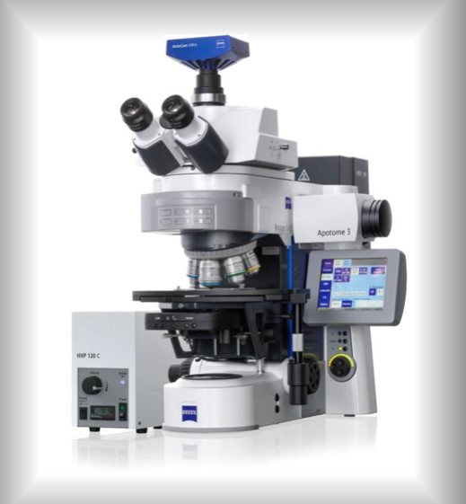

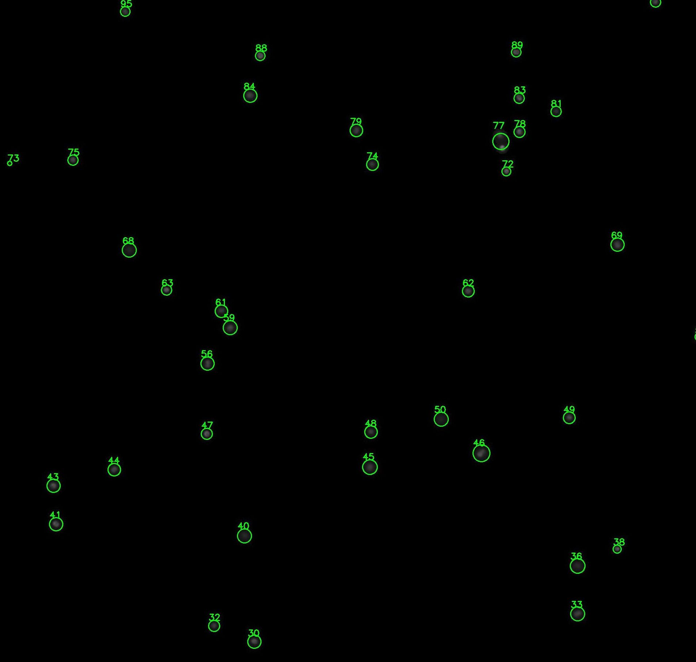
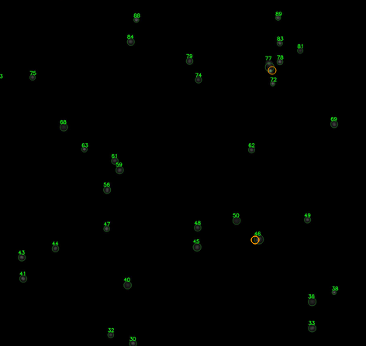
Pipette the cell suspension sample to the counting chamber
Perform fluorescence microscopy imaging
Analyze the images by this tool (see the instruction below)
Review the results and verify if all cells were identified properly
In case some cells were missed, perform manual correction

Slide 2
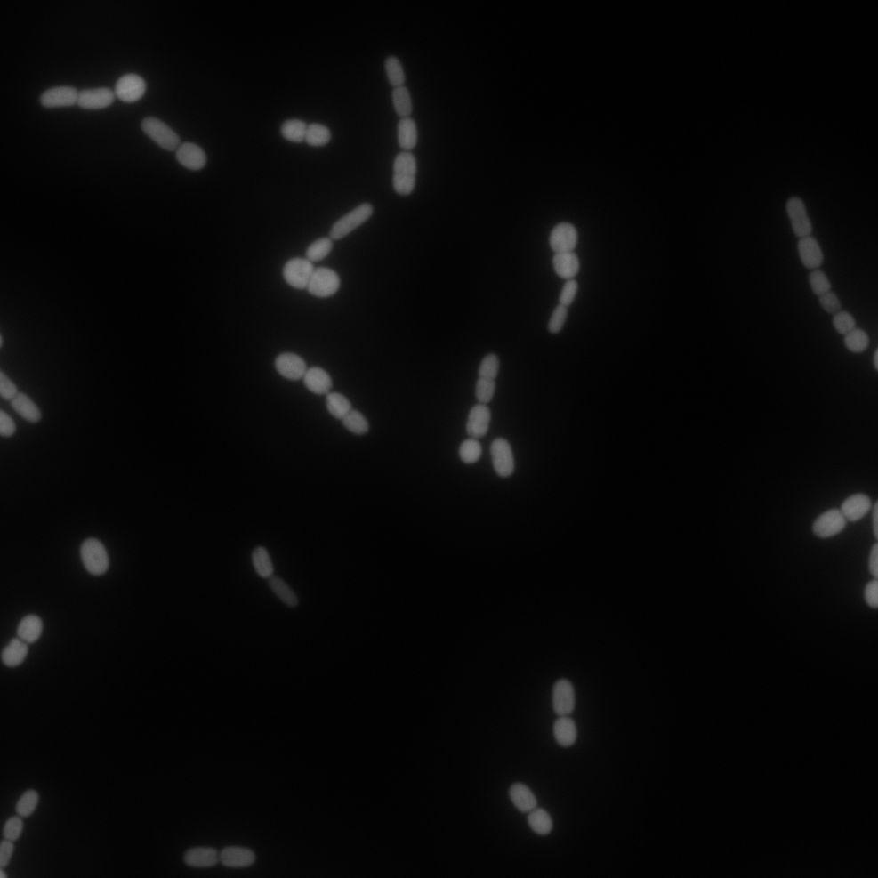
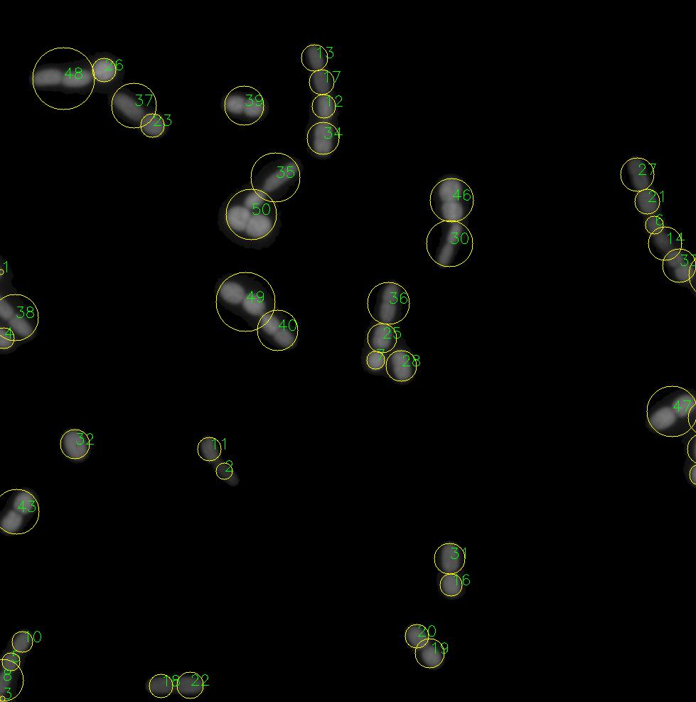
Pipette the cell suspension sample to the counting chamber
Perform fluorescence microscopy imaging
Analyze the images by this tool (see the instruction below)
Review the results and verify if all filaments were split properly and all individual cells were identified
In case some cells were missed, perform manual correction

Slide 3
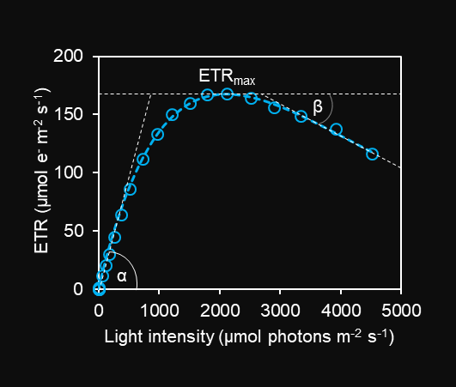
Rapid light curve example

Slide 4
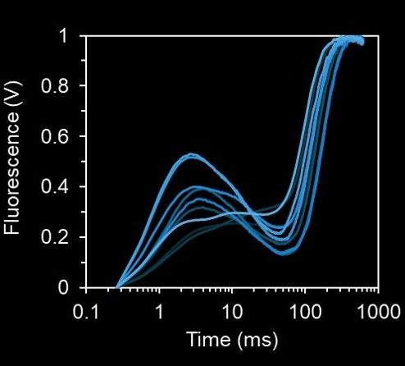
P
I
J
O

Slide 5
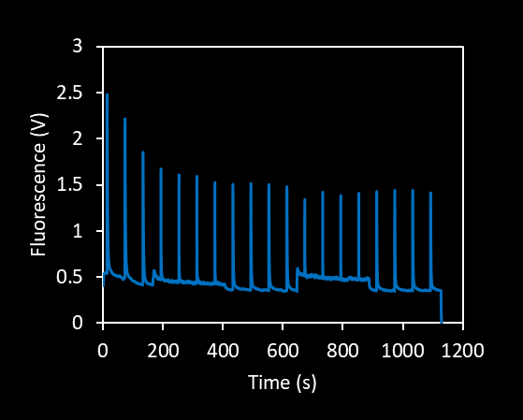
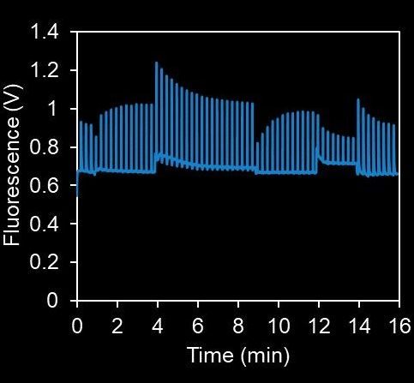

Slide 6
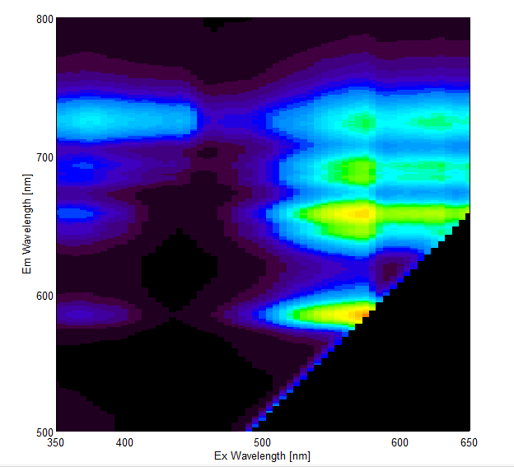
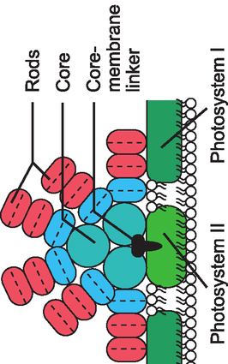
Chl a
PBS
PE
PC
PBS-PSI
Chl-PSI
PE-PSI
PC-PSI
PBS-PSII
Chl-PSII
PE-PSII
PC-PSII
PC+APC
PC+APC
PC+APC
PE
PE

Slide 7
Example 77K spectra
PBS-PSI
Chl-PSI
PE-PSI
PC-PSI
PBS-PSII
Chl-PSII
PE-PSII
PC-PSII
PBS
PE
PC+APC
PBS
PE

Slide 8
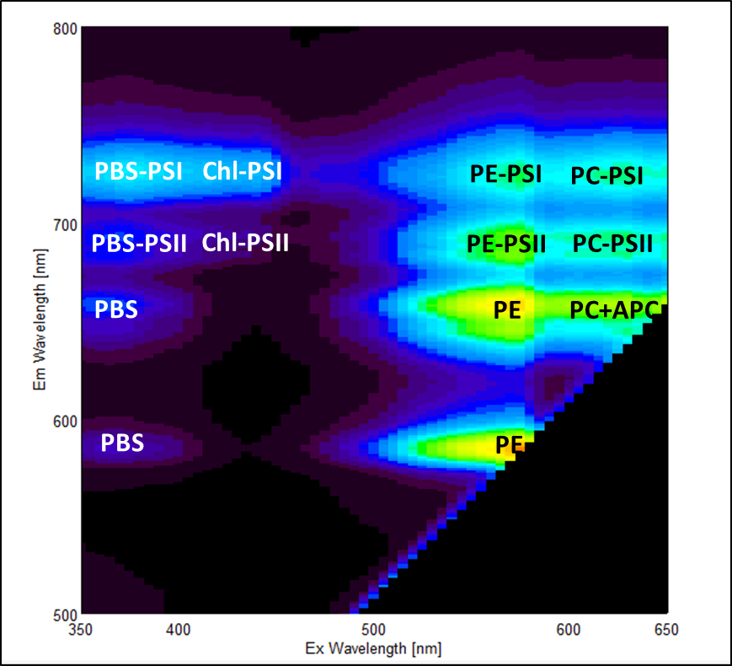
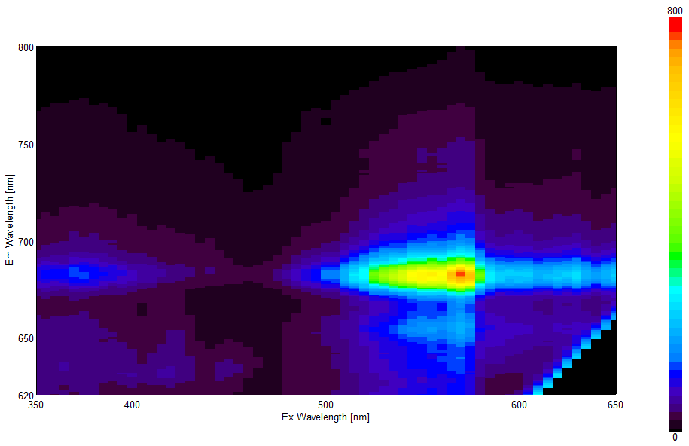
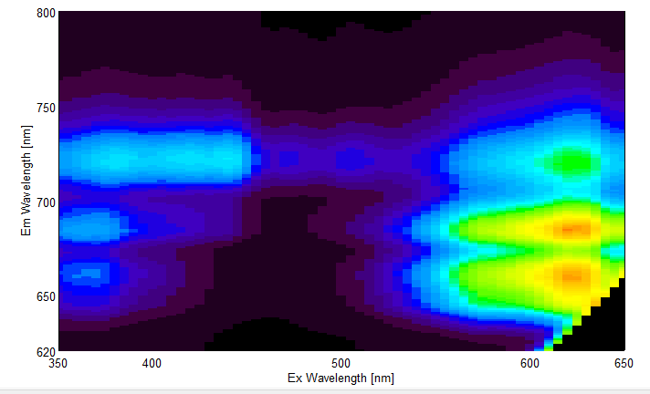
Nostoc
PE-strain
Syn 6803

Slide 9

42

Slide 10
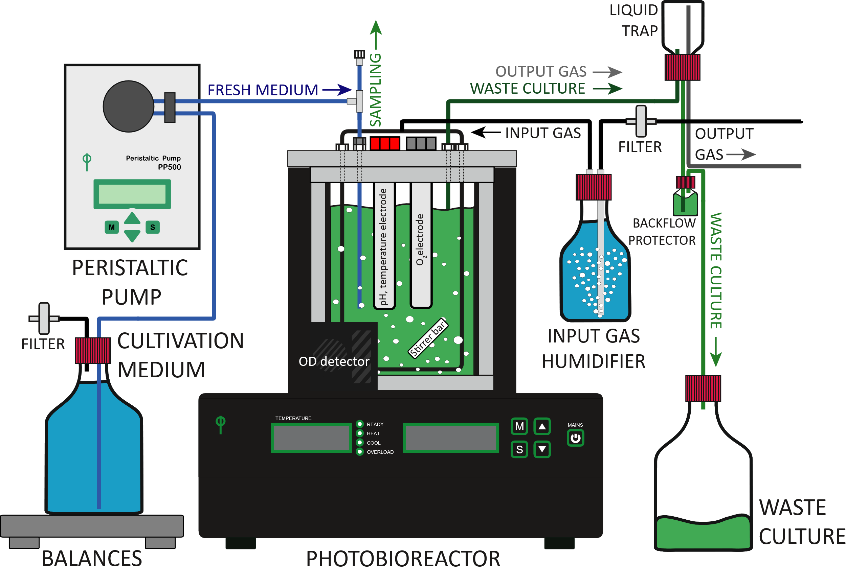

Slide 11
